Slide 1
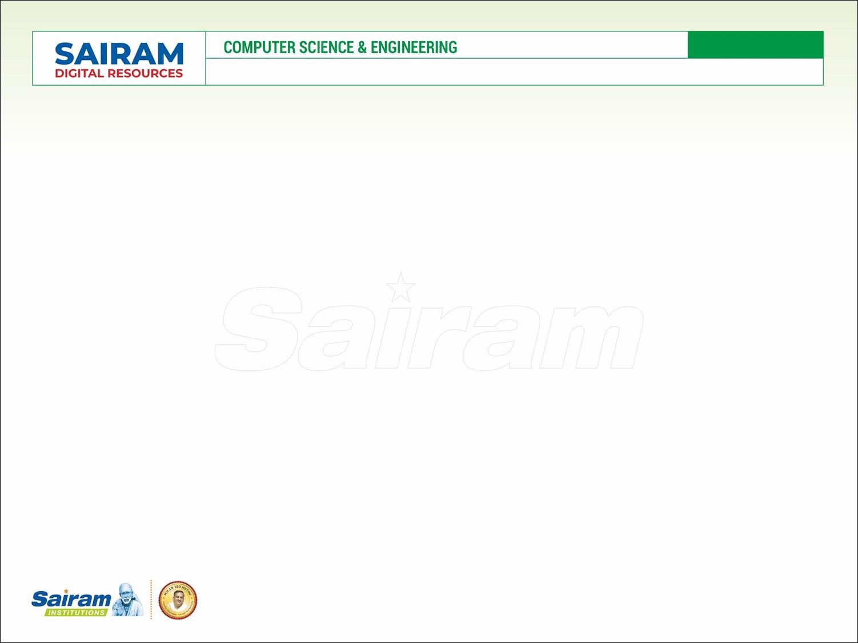
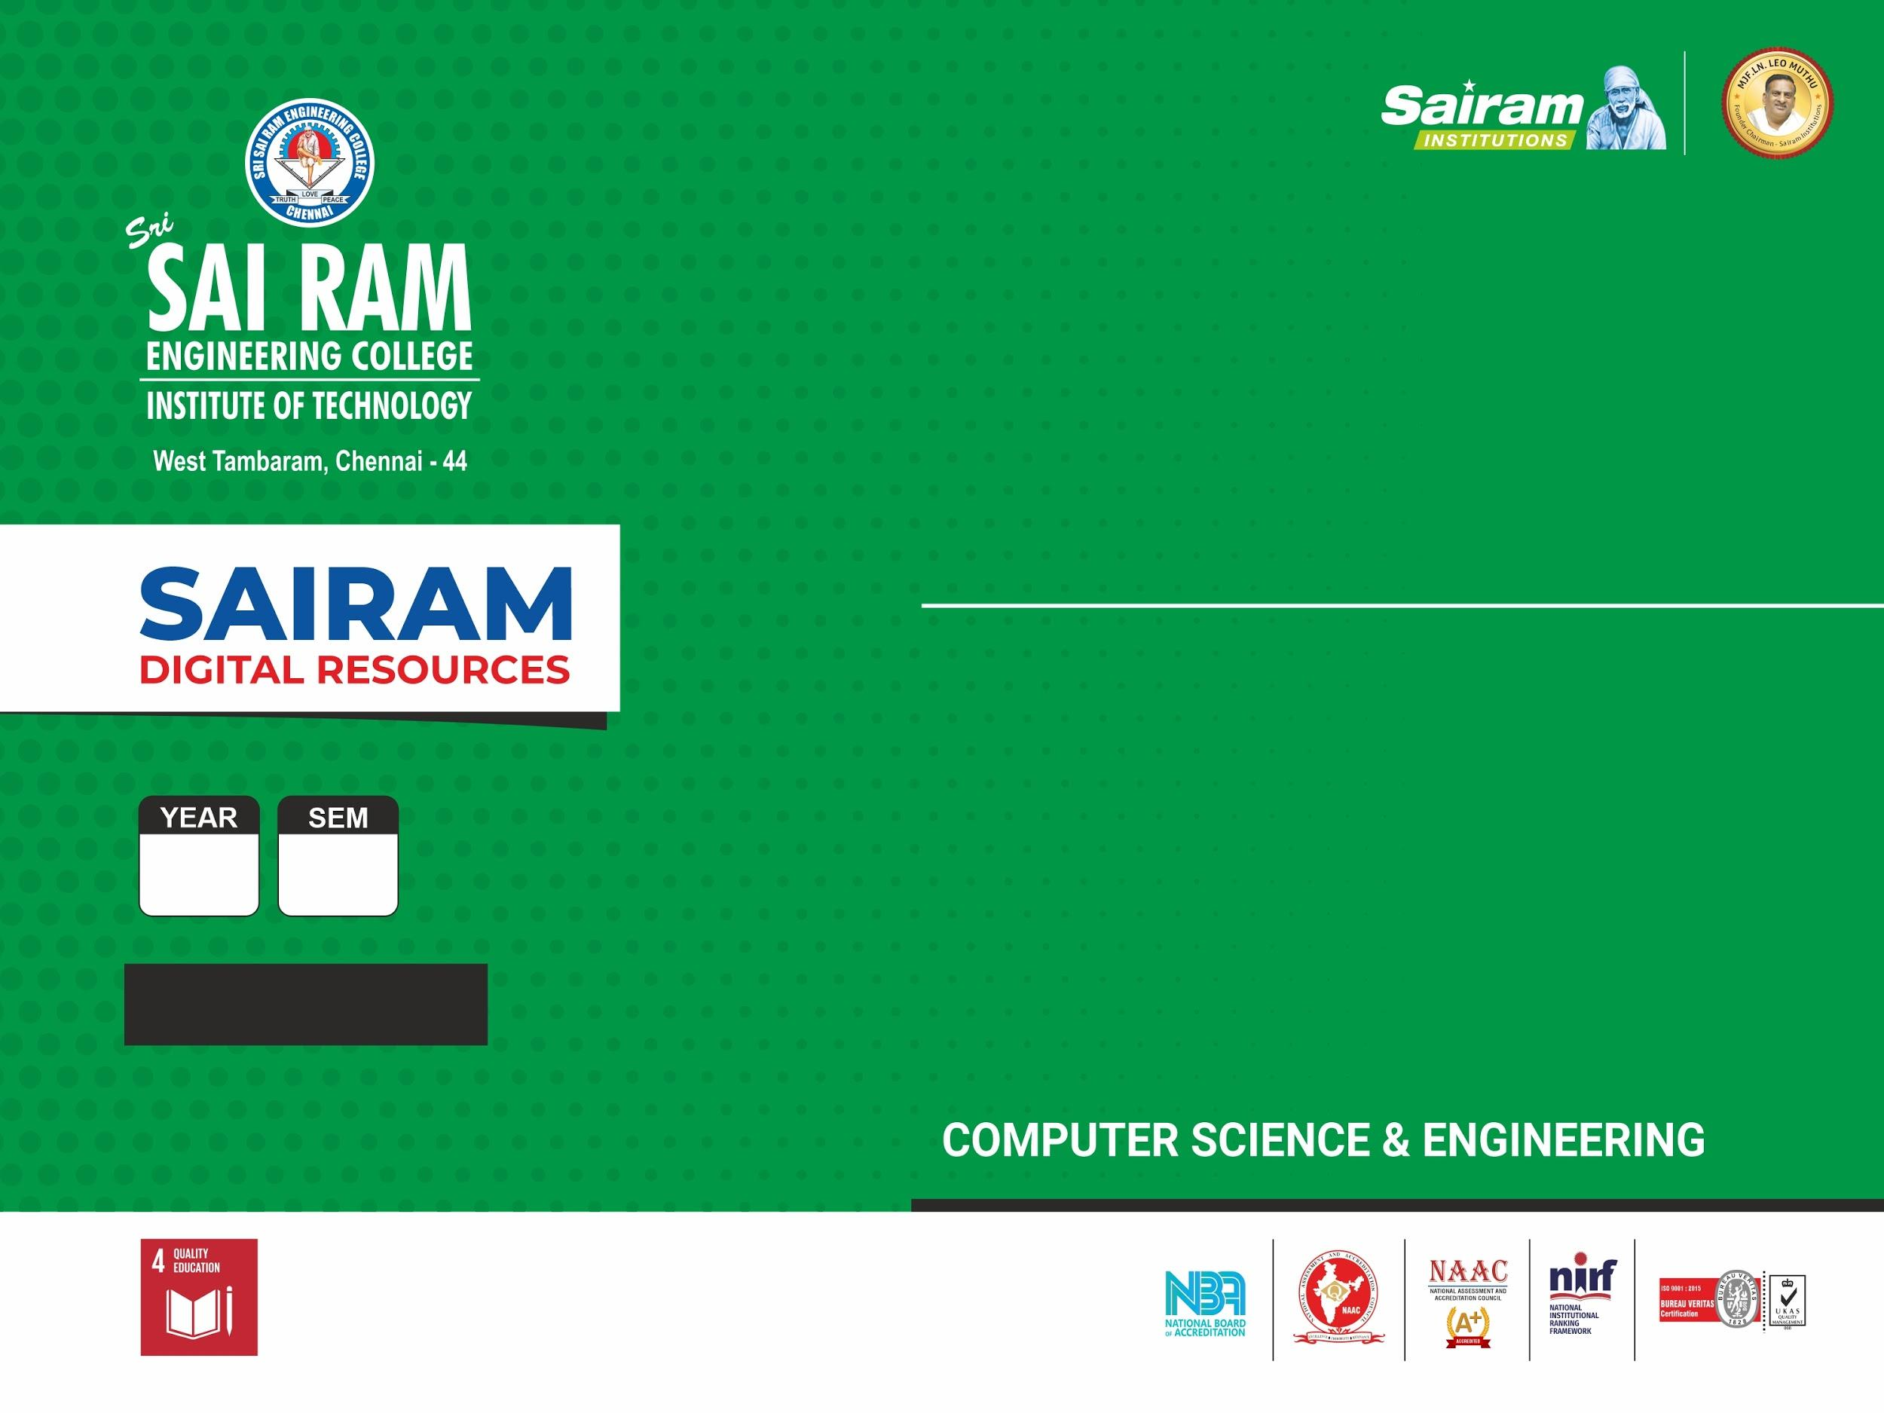
SUBJECT CODE
TYPE THE SUBJECT NAME HERE
ZEROTH REVIEW
Name : KARTHICK M
Reg. Number : 412419104049
Name : TARUN H
Reg. Number : 412419104137
Name : SYED ABUTHAHIR A
Reg. Number : 4124191040136
ORDER AND DEMAND FORECASTING THROUGH CUSTOMER BEHAVIOR AND SEASONAL PATTERN WITH RISK ADJUSTED
III
VI
CS8611
MAJOR PROJECT

Slide 2
CS8811
MAJOR PROJECT – ZEROTH REVIEW
PROBLEM STATEMENT
The Dynamic nature of the retail stores or warehouses.
Bull Whip effect in the supply chain network.
Fragmented approach to forecasting demand.
Reduced visibility due to inaccurate knowledge of demand and inventory.
Increased inventory cost because of inaccurate prediction.
Increased manual labor and resources.
Difficulty in communication between departments.
Scalability is a great drawback in every forecasting system.

Slide 3
CS8811
MAJOR PROJECT – ZEROTH REVIEW
OBJECTIVE OF THE PROJECT
Improving the financial planning of the system which lays out necessary steps to generate future income and cover future expenses.
Reducing the impact of disruption in traditional dynamic forecasts.
Accurate order forecasting and dynamic BE forecasts.
Overcoming the bullwhip effect by coming up with an enhanced forecasting model which predicts accurate results.
Enable the organization to estimate the future quantity and quality of people required for material production.
Sales strategy which is faced by retailers can be done using power pricing policy.

Slide 4
CS8811
MAJOR PROJECT – ZEROTH REVIEW
EXISTING SYSTEM
Minimum Mean Squared Error (MMSE) forecasts.
Regressive models include the Random Forest, and Linear Regression techniques.
LIMITATION
Less accuracy in material and production plan.
Purchase order for raw materials for defective and dynamic products.
Stock and overstock alerts.
Lagging in automated statistical forecasting.

Slide 5
CS8811
MAJOR PROJECT – ZEROTH REVIEW
PROPOSED SOLUTION
Implementing different machine learning techniques and comparing different models for datasets passed to that model
Enabling risk-adjusted forecasting solutions for the problem.
Implementing Data Driven Weighted Moving Average (DDWMA) model for risk-adjusted forecasting.
Using the time series sales prediction algorithm (Auto Regressive Integrated Moving Average) for comparative analysis.
The same technique will be implemented for automating the order placement system in the production unit.
Integrating an efficient forecasting model which meets customer demand will increase an organization’s profit.

Slide 6
CS8811
MAJOR PROJECT – ZEROTH REVIEW
REVIEW OF LITERATURE
SL NO | TITLE OF THE PAPER | TECHNOLOGY | JOURNAL NAME | YEAR
1 | Customer Order Behavior Classification via Convolutional Neural Network in the semi conductor industry. | Machine Learning | IEEE TRANSACTIONS ON SEMICONDUCTOR MANUFACTURING, VOL. 35, NO. 3, AUGUST 2022 | 2022
2 | A Novel Dynamic Demand Forecasting Model for Resilient Supply Chains using Machine Learning | Machine Learning | 2021 IEEE 45th Annual Computers, Software and Applications Conference (COMPSAC) | 2021
3 | Machine Learning Model for Sales Forecasting by using XGBoost | Machine Learning | 2021 IEEE International Conference on Consumer Electronics and Computer Engineering (ICCECE 2021) | 2021

Slide 7
CS8811
MAJOR PROJECT – ZEROTH REVIEW
REVIEW OF LITERATURE
SL NO | TITLE OF THE PAPER | TECHNOLOGY | JOURNAL NAME | YEAR
4 | Sales Prediction based on Machine Learning. | Machine Learning | 2021 2nd International Conference on E-Commerce and Internet Technology (ECIT). | 2021
5 | Sales Forecasting for Supply Chain demand management – A Fuzzy time series approach | Machine Learning | 2019 13th International Conference on Mathematics, Actuarial Science, Computer Science, and Statistics. | 2019
6 | Sales Forecasting of Retail Stores using Machine Learning Techniques. | Machine Learning | 3rd IEEE International Conference on Computational Systems and Information Technology for Sustainable Solutions 2018 | 2018

Slide 8
CS8811
MAJOR PROJECT – ZEROTH REVIEW
JUSTIFICATION FOR SDG
Decent work and economic growth
Since the demand is already known the workforce can either be laid off or put to overtime only when required
Industry, innovation, and infrastructure
Increase the access of small-scale industrial and other enterprises, particularly in developing countries aiding financial growth, including affordable credit, and their integration into value chains and markets.
Responsible consumption and production
Since we only procure as many raw materials as we require for production, the wastage is significantly reduced.

Slide 9
CS8811
MAJOR PROJECT – ZEROTH REVIEW
INNOVATION IN THE PROJECT
Analysing and classifying Customer Order Behavior (COB)
Increased profit of the organization due to the advancement in the prediction of future sales.
Solving the bullwhip effect in the supply chain network.
Automation in the raw material purchase system for defective products/items.
Stock management in the retail store to meet the customer demand
Implementation of a fully transparent system between different supply chain users.

Slide 10
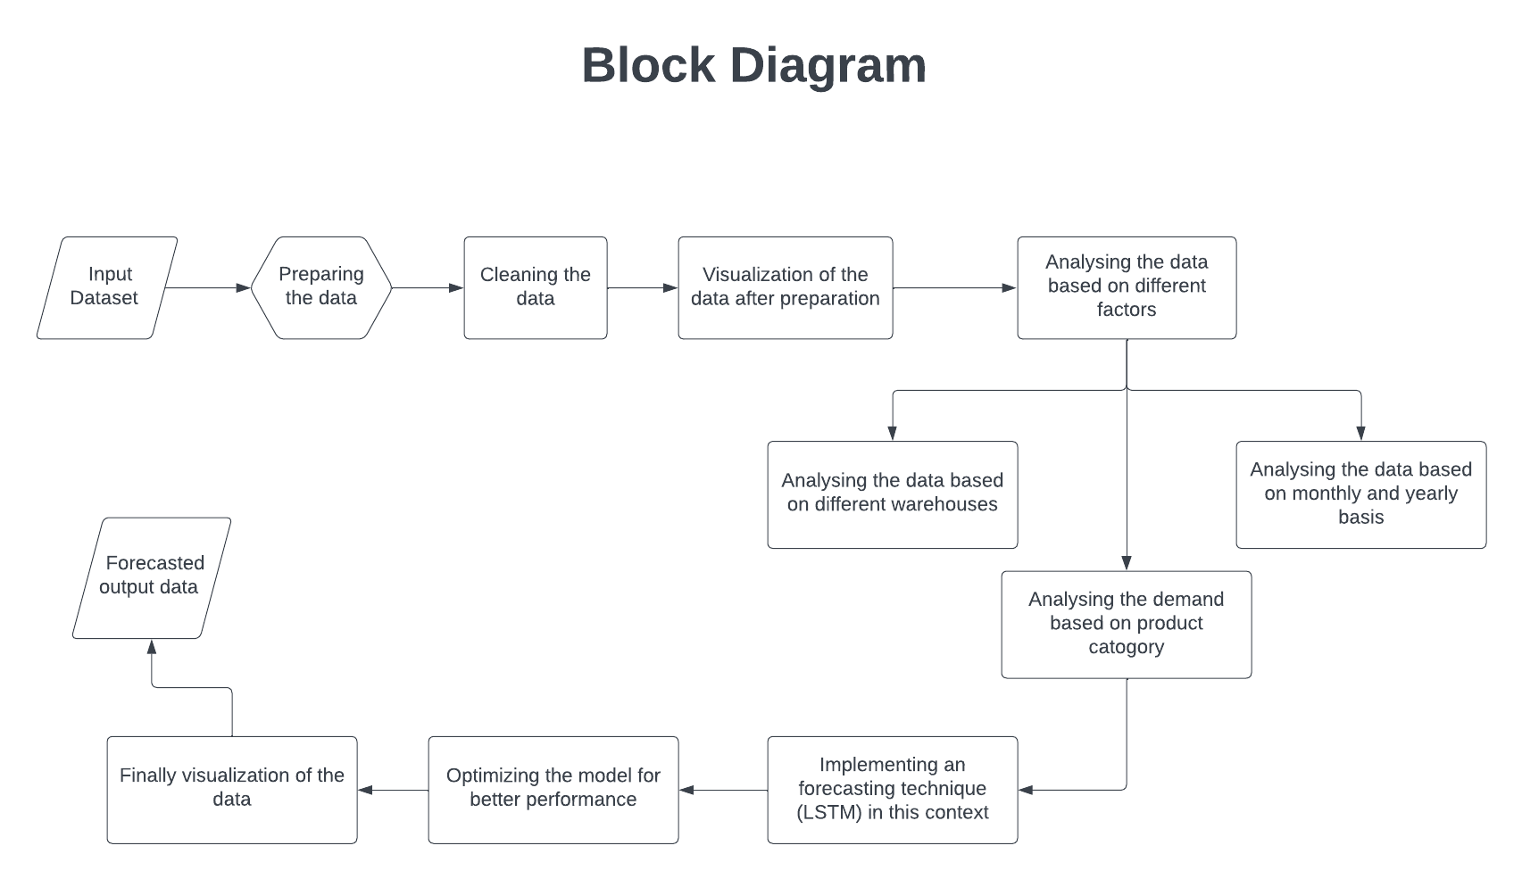
ARCHITECTURE DIAGRAM

Slide 11
CS8811
MAJOR PROJECT – ZEROTH REVIEW
THANK YOU

